Slide 1






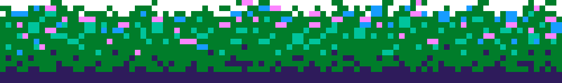
NEW HORIZON INSTITUTE OF TECHNOLOGY AND MANAGEMENT
UNI-THON
DEPARTMENT OF COMPUTER ENGINEERING
A 2D GAME USING GODOT ENGINE
BY
HARSH NAGAONKAR, 12212002
MAHESHREE KATLA, 12212036
SANA GIRISH, 12242046
GUIDED BY: MS. INDIRA JOSHI
START

Slide 2




INTRODUCTION
In this fast paced world where every minute may deduct your attendance from your lecture, we experience the life of a college university student stepping out. The game follows the player in a hurry by crossing highways and roads amidst raging traffic, crowded pavements and maintenance schedules.

Slide 3
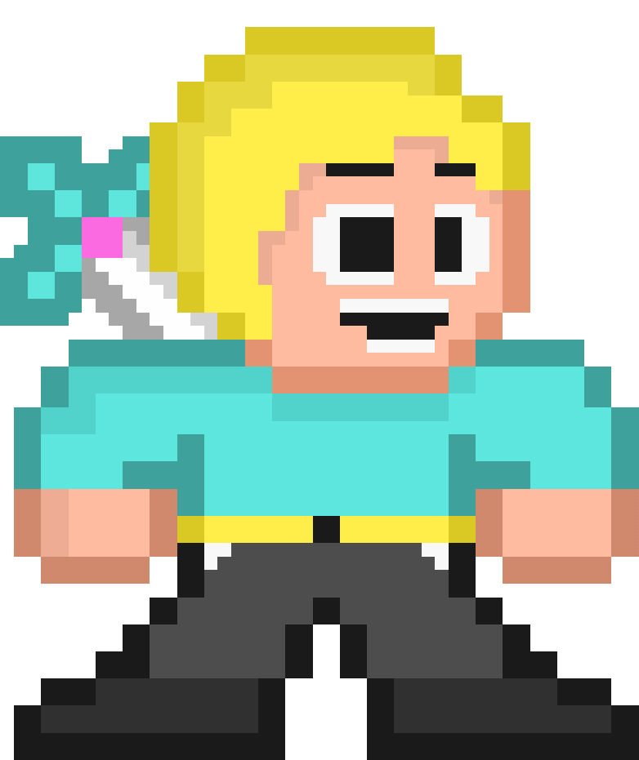
PROBLEM STATEMENT
Spending leisure time apart from academics is usually spent looking through social medias. Video games act as a great way to escape the tiresome reality and enjoy some time invested in them. But they tend to be rather big in size or just grabs all your attention making you rather anxious and psychologically embedding the thought of competitiveness. Keeping these out of the picture a theme rather comforting and relatable tends to stick with us well. There is a lack of games having a theme set around the player’s life with a transparent outlook with minimal concentration required but guarantees fun. Seeing everyday objects which are rather too common for us in a video game gets the players really excited and curious. Keeping the theme to a rather daily routine as the main objective of our game with an arcade style keeps the players from replaying the game with various strategies thereby not getting bored and finding a new detail every time.

Slide 4


OBJECTIVES
Establish a sense of familiarity: Players would recognize the setting of the game and would be able to relate with them as well as look everyday objects in pixel art style keeping them curious and entertained.
Requires minimal concentration with short but fun gameplay: Create a game which does not require being highly attentive but is relaxing to play anytime with a simple aim of reaching the goal.
Easy to play anytime: Controlling the character with just a couple of keys would make it ideal to play regardless of age or hardware.
A virtual take on the fast-paced competitive living: Psychologically, it portrays the ever-running state of society that exists today, keeping no room for patience and thinking about others. It also highlights the average routine of a college student once they step out of their home and the various tales of travel in this society.

Slide 5







THEME
AGE RATING
REQUIREMENTS
Casual pixel art style game with obstacles, enemies and a set distance to reach in the alloted time
Age 8 and up
Any Operating System PC/Laptop.
BUILDING THE GAME
ENGINE
ASSETS
PROGRAMMING
Godot, an Open Source engine where you can make both 2D and 3D games with the help of various Nodes and manipulating their properties along with an inbuilt code editor.
Libresprite, a free and Open Source program for creating and animating your sprites
GDScript, a high level, object-oriented, imperative and gradually typed programming language built for Godot

Slide 6

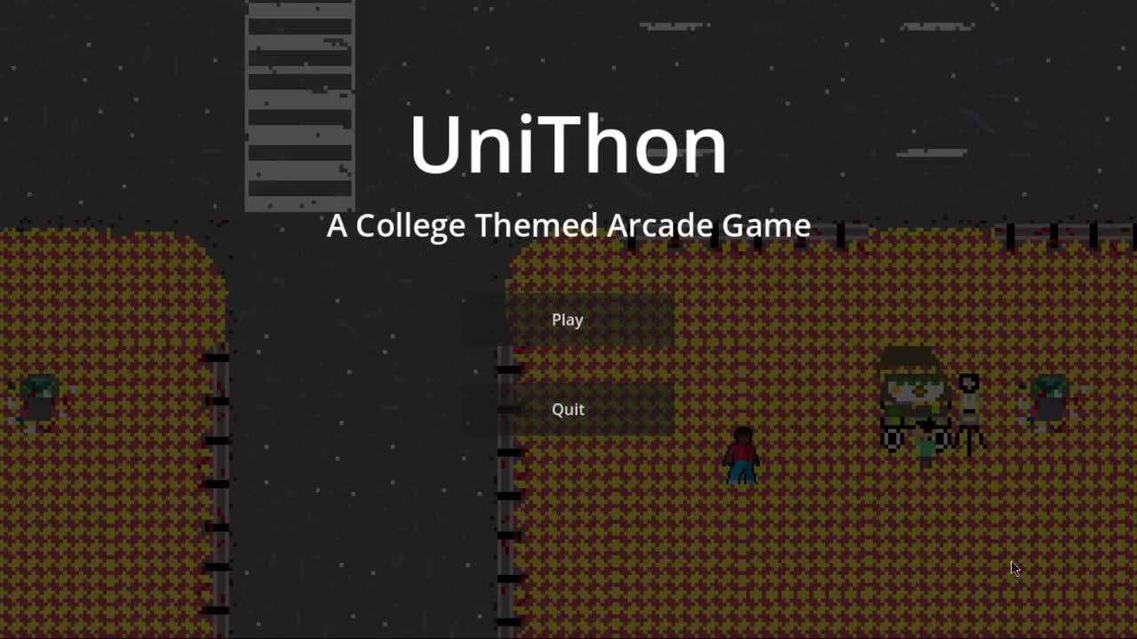




WORKING
Simple WASD or Arrow keys movement for the Player. They can also move diagonally. Dodge incoming traffic on highways and roads because who waits for the red light? Move swiftly through pavements and walkways through crowds and avoid falling into any manholes or ditches, meanwhile keeping a side eye on the clock.
HELP ME REACH MY COLLEGE AND MOST IMPORTANTLY, KEEP ME ALIVE

Slide 7







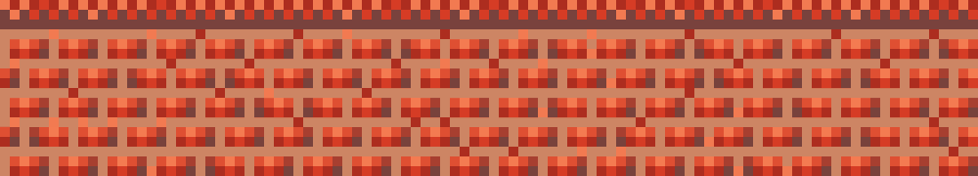
WORKFLOW
Make/Import necessary assets for the game
Implement them in the editor and form node structures
Bind these nodes together using the editor and GDScript Language

Slide 8
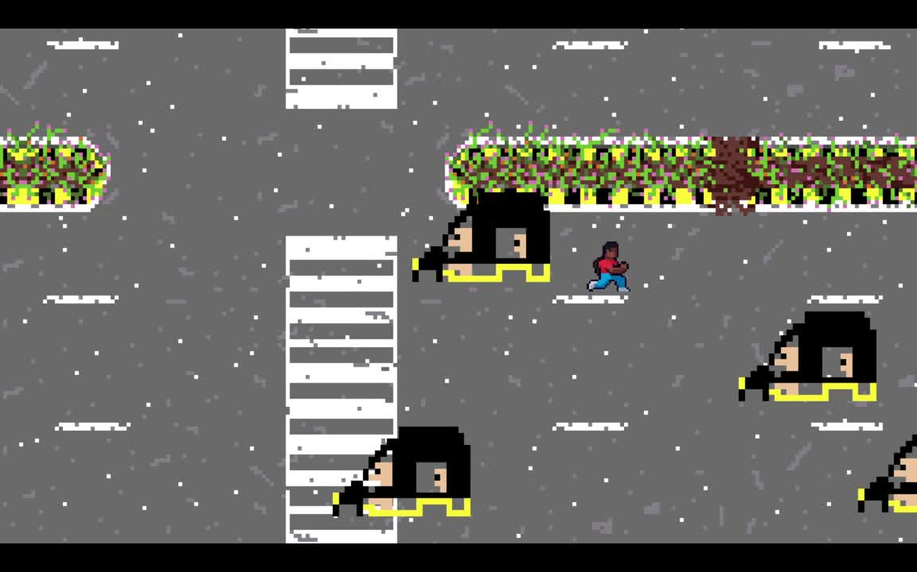







Decision Making
Test the player’s decision making speed and how the player would find the best decision.
Perception
Ability to keep track of all objects such as hostiles, shortcuts on the screen.
Hand Eye Coordination
“Games offer unique perspectives and a break from reality where violence is optional” - Gandhi
How well the player coordinates through perceived information and tackles the problem with his motor muscles.
Problem Solving
Find a solution to the problem efficiently with new possible ways and learn through the mistakes.

Slide 9






References
“Making a 2D Game with Godot 4 Engine” – Son Nguyen, Bachelor’s Thesis, May 2024.
“Game Development Using the Open-Source Godot Game Engine” – Tero Salmela, May 2022.

Slide 10





Thank you!

